Slide 1
Non-contact Detection of Glucose Concentration – Monte Carlo Simulation
By R. Davis, M. Xu

Slide 2
Outline of Presentation
Background
Motivation
Electric Field Monte Carlo Simulation – Coherent Light Backscattering from Glucose Solution
Results
Summary

Slide 3
Background
Glucose is an important molecule to metabolism: it is the primary way of transport of carbohydrates as well as important fuel in cells.
Diabetes mellitus is a group of diseases in which either:
The person does not produce enough insulin (Type I)
The cells do not respond to insulin that is produced (Type II)
Diabetes patients have to constantly prick themselves to check their blood sugar levels.

Slide 4
Type I vs. Type II
Type I :
Called the insulin-dependent diabetes mellitus or juvenile diabetes
Type II:
Related more to modern life style or adult diabetes
Constitutes >95% of all diabetic patients and effects over 25 million people in the US, and over 340 million in the world.
Both types require constant monitoring of glucose concentration

Slide 5
Current Invasive Methods
Have to constantly monitor their glucose levels
Prick finger, drop onto to strip to insert into glucometer
Flux of the reaction creates an electric signal and responds to the electrical strength

Slide 6
Current Non-Invasive Methods
Some Solutions:
Photo-acoustic Spectroscopy
Optical Coherence Tomography (OCT)
Scattering
Other Less Successful Solutions:
Cnoga Medical Ltd. - Combo Glucometer
Oculir
Integrity Applications Ltd.

Slide 7
Three Main Optical Methods for Sensing Glucose Concentration
Absorption
01
Scattering
02
Polarization
03

Slide 8
Absorption
One way to do optical detection of glucose is through absorption

Slide 9
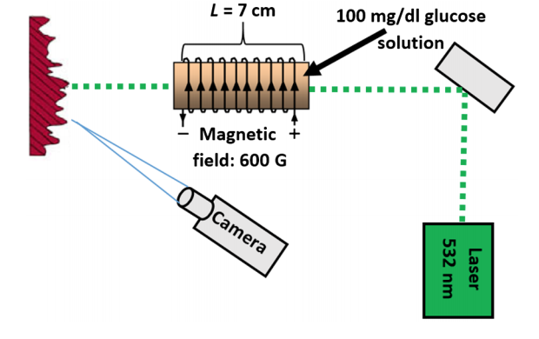
Scattering
Optical sensor based on the magneto optic effect
Uses the rotation of polarized light which passes through the medium subject to a magnetic field
The linear polarization will rotate because of the Faraday Effect due to Glucose
The intensity of the Speckle field of the backscatter light changes

Slide 10
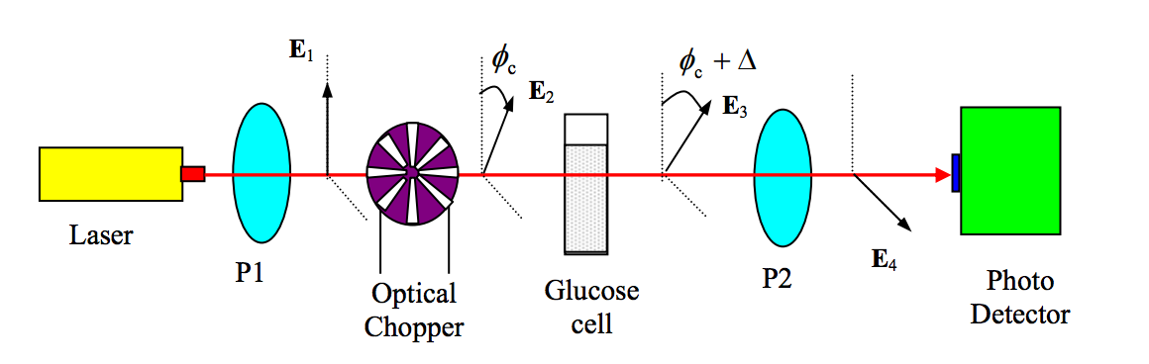
Polarization
Based on the rotation of the light through the turbid medium.

Slide 11
Challenges of Non-Invasive Glucose sensing
Accuracy
Reliability
Ultra-sensitivity
Fast Response
Low Cost Per Test

Slide 12
Focus of the Capstone Study
Implement electric field to Monte Carlo code to study the light backscattering from glucose suspension with the presence of the magnetic field.
Perform a study on the noninvasive method through a Monte Carlo Simulation and find the effect of Faraday rotation on Coherent Backscattering effect

Slide 13
About the Monte Carlo Simulation
Monte Carlo simulation is a broad class of computational algorithms that rely on repeated random sampling to obtain numerical results. Their essential idea is using randomness to solve problems that might be deterministic in principle.
In our case we explore the EMC – Electric field Monte Carlo - which is one special kind of the simulation

Slide 14


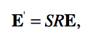


EMC Explained
n
n'
s
m
s'
m'
Notes:
E is the complex electric field with components parallel and perpendicular to the previous scattering plane,
E' is the complex electric field with components parallel and perpendicular to the present scattering plane,
S is the amplitude scattering matrix dependent on the scattering angle θ between the incoming propagation direction and outgoing propagation direction, and
R is the rotation matrix dependent on the angle φ between the incoming perpendicular electric field component and the outgoing perpendicular electric field component.
The rotation matrix R rotates the reference frame φ degrees azimuthally to align the incoming perpendicular electric field component to the normal of the present scattering plane

Slide 15
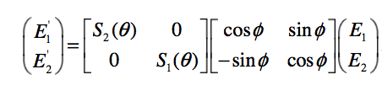
S Matrix
$E_{1}$ and $E_{2}$ are the complex parallel and perpendicular components of the incoming
electric field and $E_{1}′$ and $E_{2}′$ are the complex electric field components after the scattering event.
Notes:
The properties of the scattering particle are contained in the S matrix: S1 and S2 dependent on the refractive indices inside and outside the particle as well as the size of the
particle and the wavelength of the incident light.

Slide 16
What is the CBS Phenomena
CBS – or Coherent Backscattering Enhancement
Weak localization of light can be detected since it is manifested as an enhancement of light intensity in the backscattering direction

Slide 17
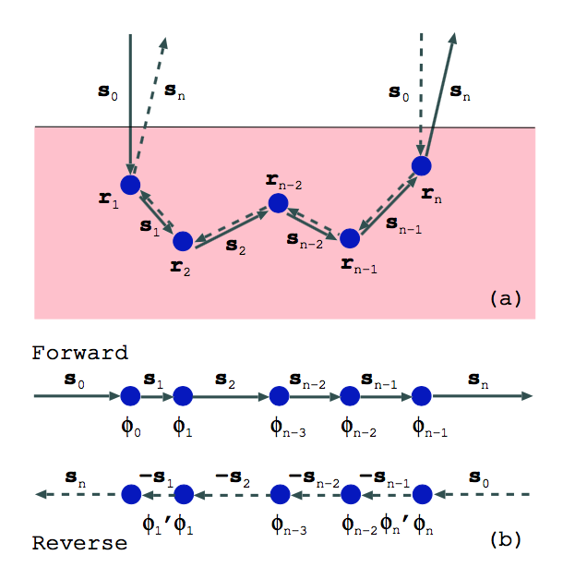

Slide 18
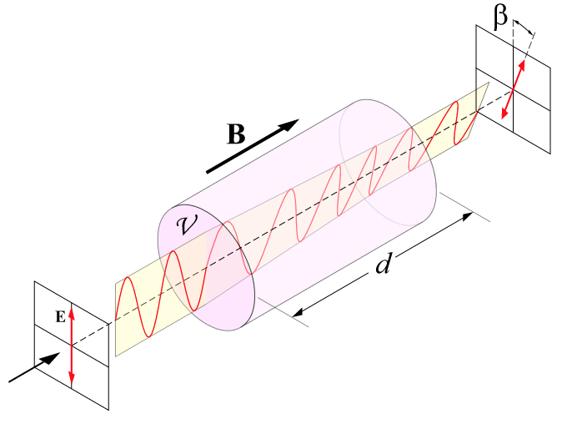

Incorporating Faraday Rotation by Glucose
The foundation for the detection:
$$θ= θB∙l$$

Slide 19
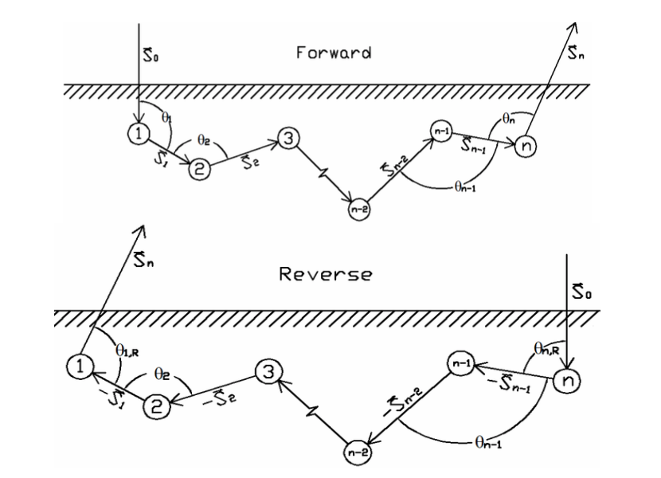
forward and Reverse - path
This is an example of the path being in the forward and reverse direction if the initial entry point is straight

Slide 20
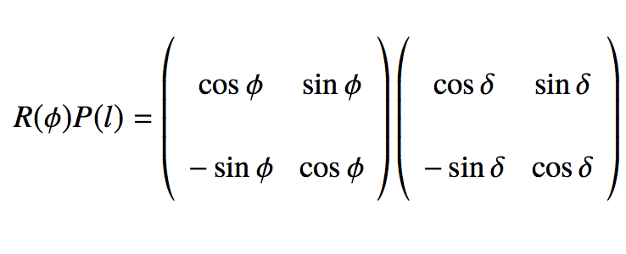
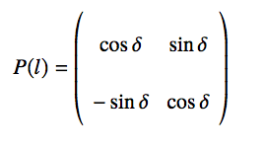
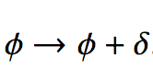
Varying the angle of rotation Due to Faraday
We accommodate for the Faraday rotation by adding a P factor to the already existing rotation
$$R\left(φ\right)=\left(\begin{matrix}\cos{φ} & \sin{φ} \\ −\sin{φ} & \cos{φ}\end{matrix}\right)$$
$δ=\frac{1}{2}(θ_{x}B_{x}δx+θ_{y}B_{y}δy+θ_{z}B_{z}δz)$

Slide 21
Before the Introduction of the Faraday Effect
After the Introduction of the Faraday Effect
Before the Introduction of the Faraday Effect
After the Introduction of the Faraday Effect

Slide 22
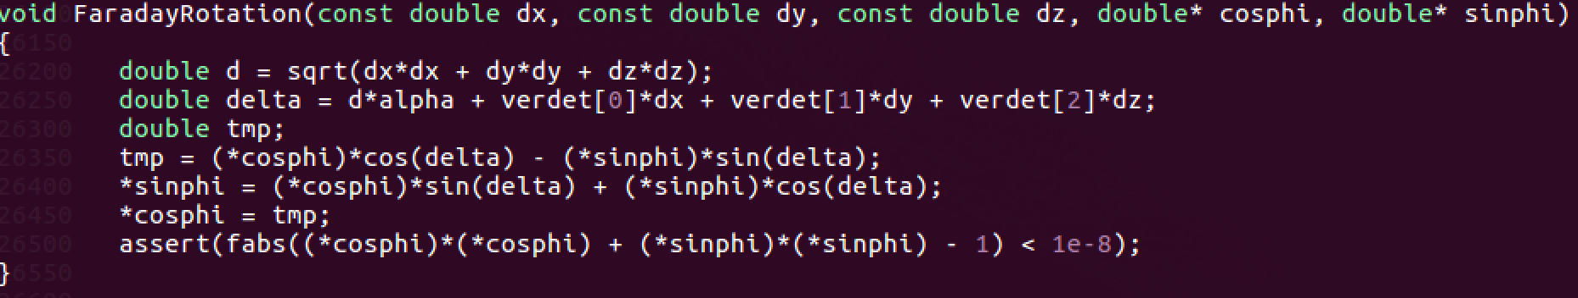

Slide 23
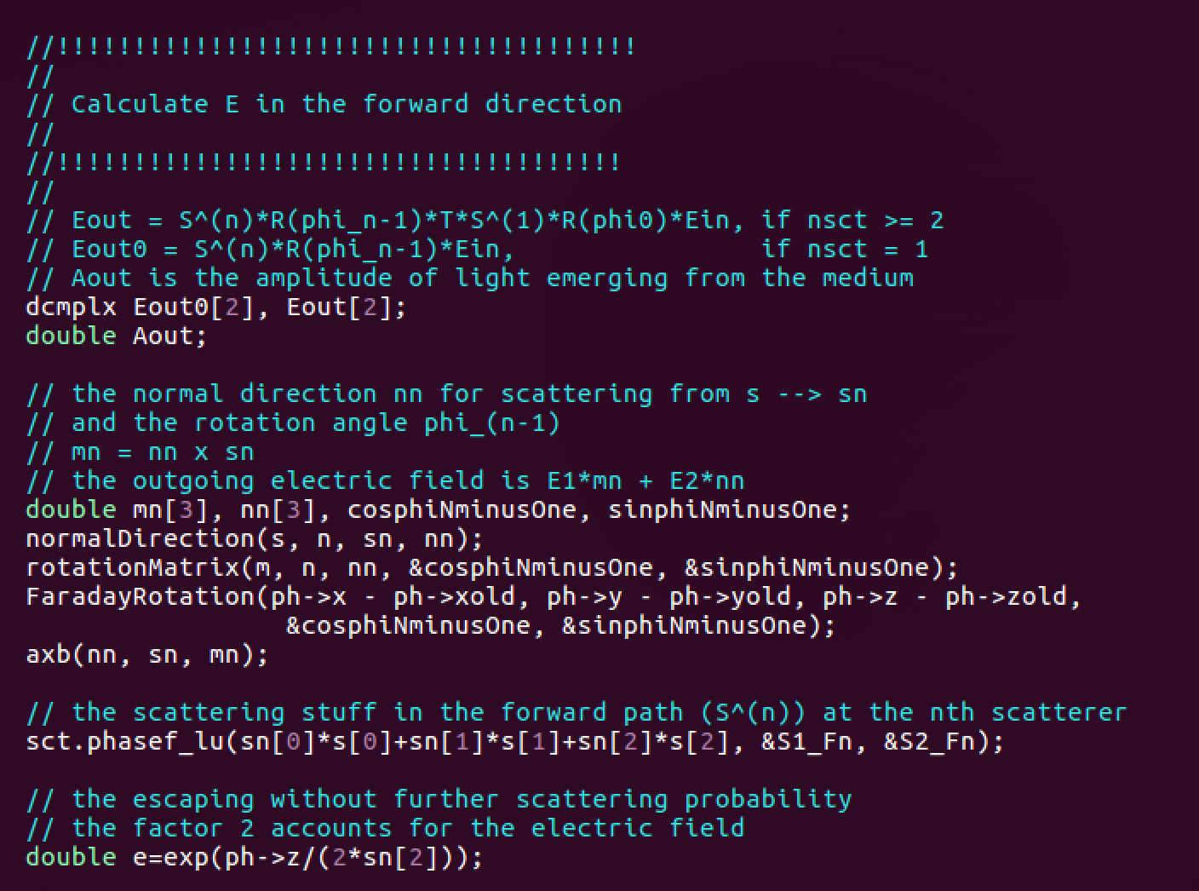

Slide 24
Results
1.674 when Verdict Constant 0.0039
1.677 when Verdict Constant 0
1.4417 when Verdict Constant is 0.3
0.2% difference between the glucose verdict factor and no magnetic field present.

Slide 25
Coherent Backscattering Factor

Slide 26
Faraday Rotation vs. Enhancement Factor
1.675 when Verdict Constant 0
1.51 when Verdict Constant is 0.3

Slide 27
Relationship between simulation and Reality
Bx
Figure to show magnetic field in the x -direction

Slide 28
Summary:
Ability to simulate – using the Monte Carlo simulation - Faraday rotation inside a turbid medium
Ran simulation to to detect the CBS when there is a magnetic field through a glucose solution
There is a small difference. The challenge is to improve the detection, then it would be possible to do Locking detection.

